Slide 1
MODULATION SPECTRUM EQUALIZATION FOR ROBUST SPEECH RECOGNITION
Source: Automatic Speech Recognition & Understanding, 2007. ASRU. IEEE Workshop on
Author : Liang-che Sun , Chang-wen Hsu, and Lin-shan Lee
Professor : 陳嘉平
Reporter : 楊治鏞

Slide 2
Introduction
The performance of speech recognition systems is very often degraded due to the mismatch between the acoustic conditions of the training and testing environments.
In this paper, we propose a new approach for modulation spectrum equalization in which the modulation spectra of noisy speech utterances are equalized to those of clean speech.

Slide 3
Introduction
The first is to equalize the cumulative density functions (CDFs) of the modulation spectra of clean and noisy speech, such that the differences between them are reduced.
The second is to equalize the magnitude ratio of lower to higher components in the modulation spectrum.

Slide 4


Modulation spectrum (1/2)
Given a sequence of feature vectors for an utterance, each including D feature parameters,
where n is the time index, and is the parameter index.

Slide 5
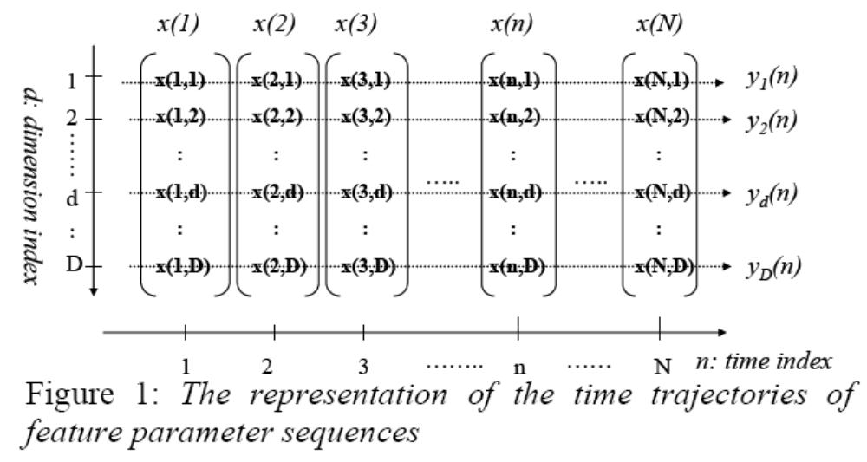

Slide 6


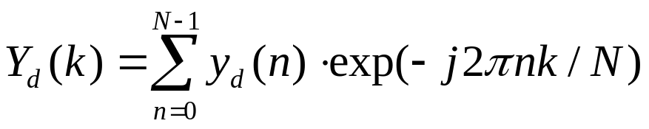


Modulation spectrum (2/2)
The modulation spectrum of the -th time trajectory can be obtained by applying discrete Fourier transform:

Slide 7


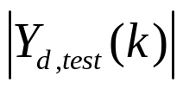

Spectral Histogram Equalization
We first calculate the cumulative distribution function (CDF) of the magnitudes of the modulation spectra, , for all utterances in the clean training data of AURORA 2 to be used as the reference CDF, .
For any test utterance, the CDF for its modulation spectrum magnitude, , can be similarly obtained as .

Slide 8
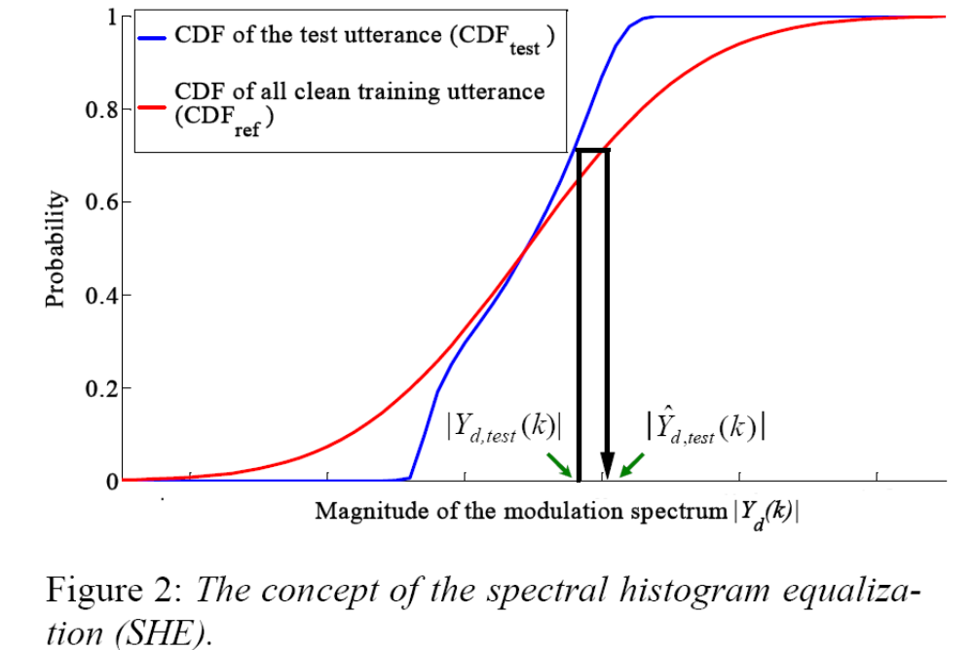

Slide 9
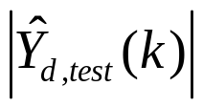
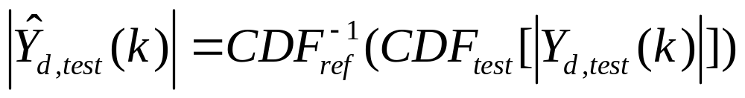
Spectral Histogram Equalization
Hence the equalized magnitude of modulation spectrum is

Slide 10

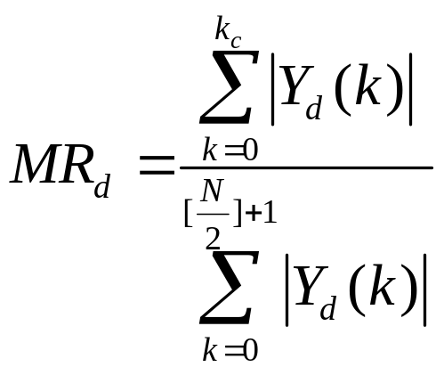


Magnitude Ratio Equalization
We first define a magnitude ratio (MR) for lower to higher frequency components for each parameter index as follows:
where is the cut-off frequency used here, is the order of the discrete Fourier transform.

Slide 11
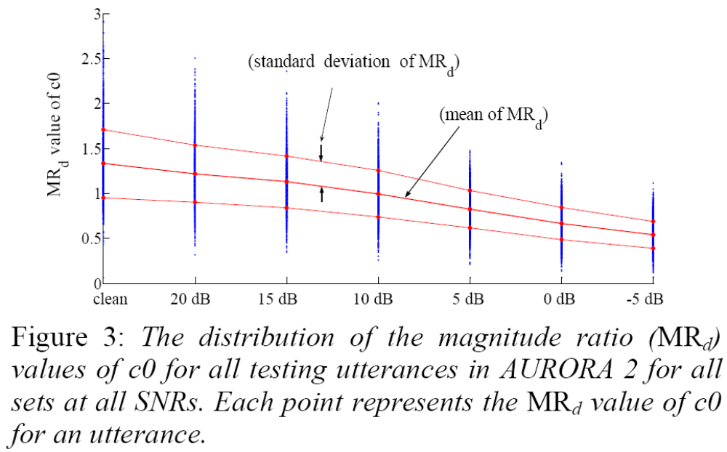

Slide 12
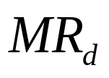
Magnitude Ratio
We can observe from this figure that the mean value of is degraded when SNR is degraded, and thus is highly correlated with SNR.
It is therefore reasonable to equalize the value of for a noisy utterance to a reference
value obtained from clean training data.

Slide 13
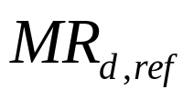
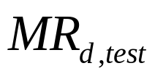
Magnitude Ratio Equalization
We first calculate the average of for all utterances in the clean training data of AURORA 2 as the reference value .
We then calculate the value of for each test utterance as .

Slide 14
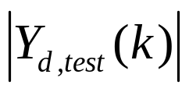
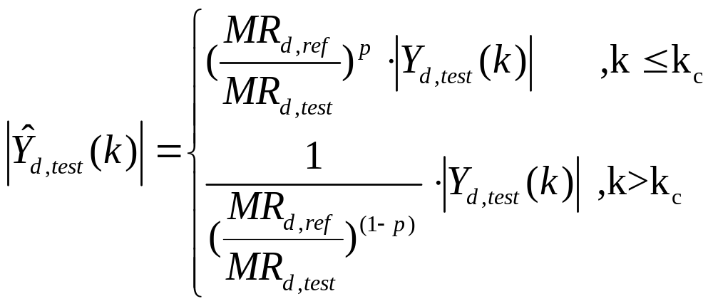

Magnitude Ratio Equalization
We equalize the magnitude of the modulation spectrum for the test utterance as
where is the weighted-power for the scaling factor.

Slide 15
EXPERIMENTAL SETUP
AURORA 2
The speech features were extracted by the AURORA WI007 front-end.
Figure 4

Slide 16
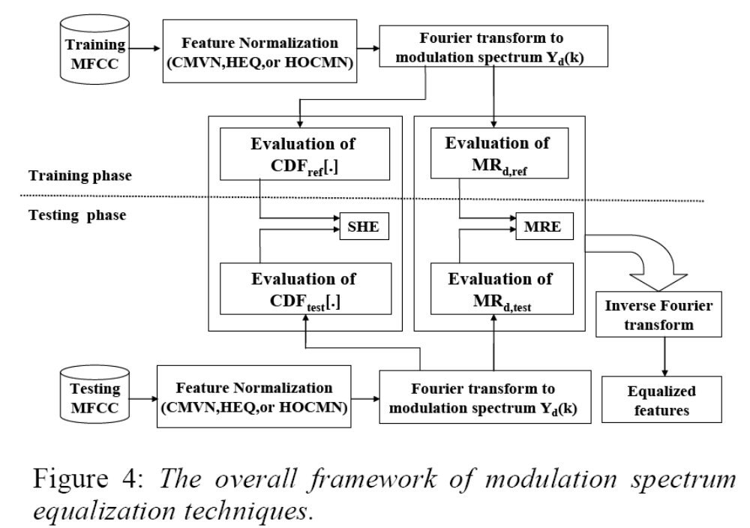

Slide 17
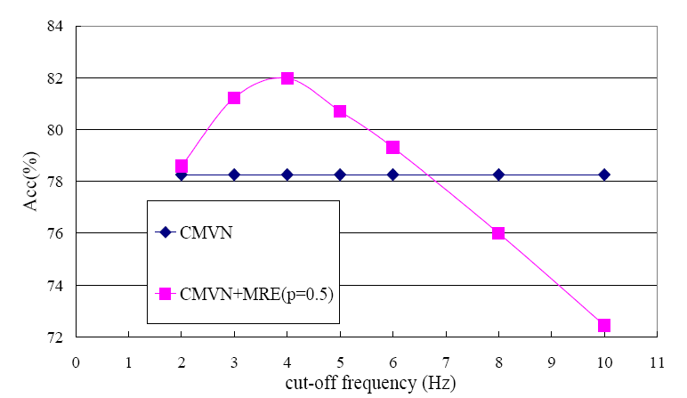

Slide 18
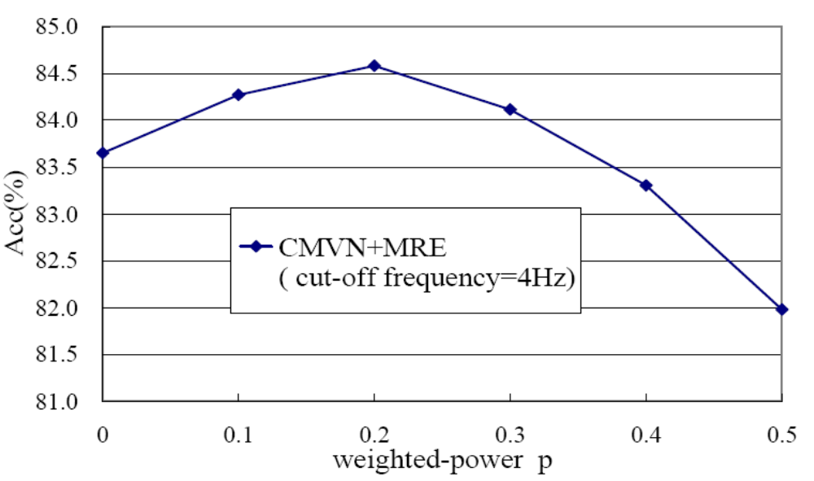

Slide 19
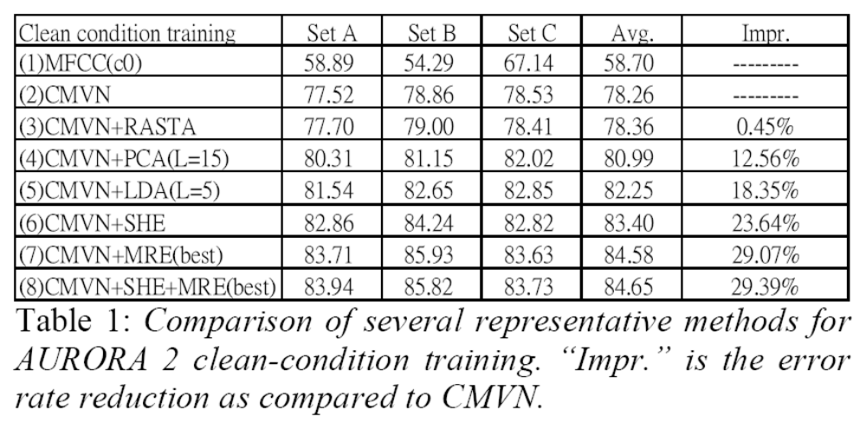

Slide 20
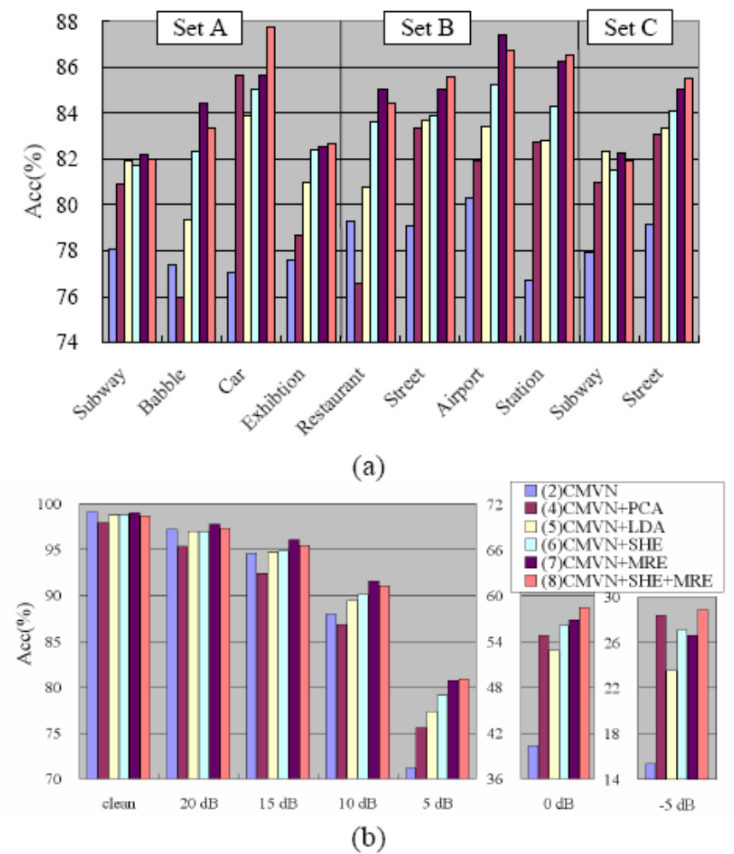

Slide 21
Integration of MRE with Other Feature
Normalization Techniques
We only consider MRE here because the additional improvements obtainable with SHE+MRE as shown in Table 1 were found to be limited, and indeed involved much higher computational costs.

Slide 22
